Slide 1
Chapter 3 Homework
习题
Which is needed to uniquely identify a TCP Socket and a UDP socket respectively in the network?
答：TCP采用四元组<目的IP,目的端口，源IP，源端口>进行唯一标识，UDP采用二元组<目的IP，目的端口>进行唯一标识
In the TCP/IP model, what is the first layer from the bottom up that implements end-to-end transport?
答：传输层
When a user uses a user agent to access the mailbox to send and receive mails, what application layer protocol are possibly used?
答案是SMTP、POP3、IMAP、DNS

Slide 2
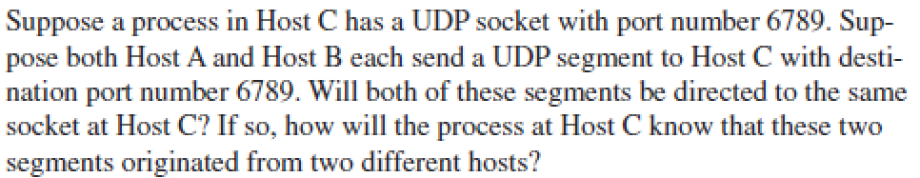
Chapter 3 Homework
习题
答：是的，这两个报文段将被发送到相同的套接字。主机C会根据源IP地址来进行区分

Slide 3
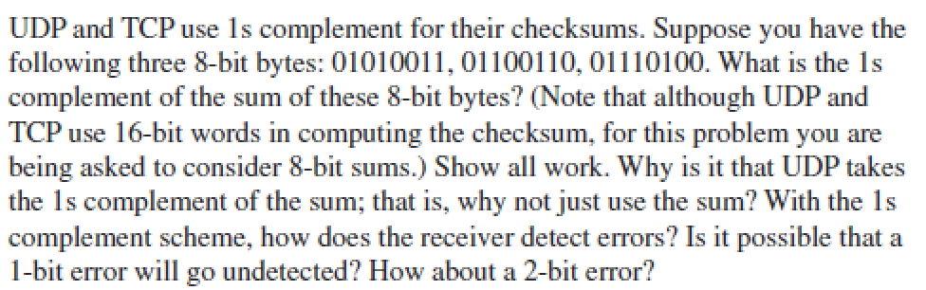
Chapter 3 Homework
习题
答：反码为：1 1 0 1 0 0 0 1
接收端会将4个8bit字全部相加，若结果中出现0，则代表出现错误。所有的1bit错误都会被检测到，但2bit错误可能无法检测，如出现在同一列

Slide 4
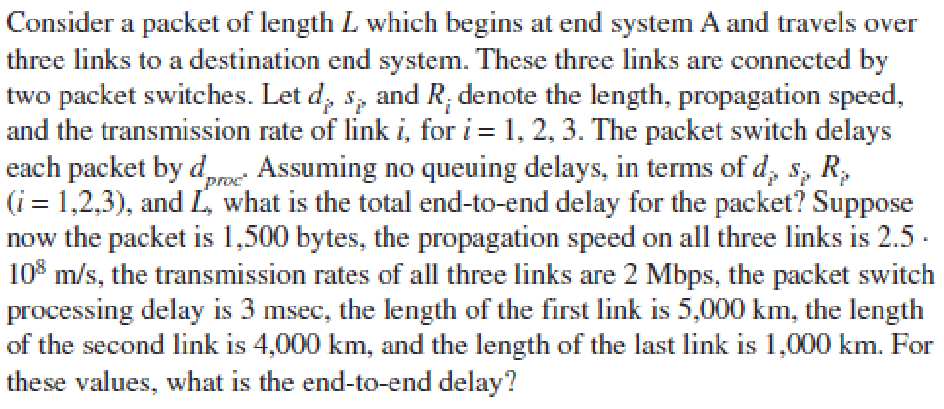
Chapter 3 Homework
习题
答：总的端到端时延：
d_{end-end} = L/R₁ + L/R₂ + L/R₃ + d₁/s₁ + d₂/s₂ + d₃/s₃+ d_{proc}+ d_{proc}
带入数字计算，值为：64 msec （注意字节需要*8的转换）

